Slide 1

Announcements
Just reminders to let me know if you have any questions about your grade
And not to use AI to complete your labs

Slide 2
HR Diagrams
One Star, Two Star, Red Star, Blue Star

Slide 3
First, Some Physical Laws

Slide 4

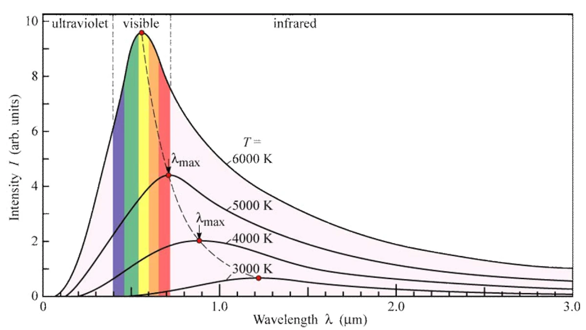
Wien’s Law
Note that the constant on the right is given in units of nanometers (in this case)
The temperature is in Kelvin
Relates the peak wavelength (λ) of emitted light to the temperature (T) of an the object
Peak wavelength means the wavelength that more of the light is at than any other wavelength

Slide 5

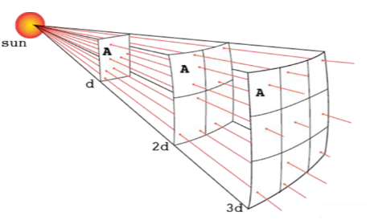
Inverse Square Law
The 4𝝅r² on the bottom is the surface area of a sphere
Because light (or sound) spreads out in every direction - which means it spreads spherically
The bigger the sphere (the bigger the radius - how far you are from the source) the more spread out the light is
So, as you get further away, the light intensity decreases by the square of that radius
2 times further away, 2²=4 times less light
3 times further away, 3²=9 times less light
5 times further away, 5²=25 times less light
etc.

Slide 6

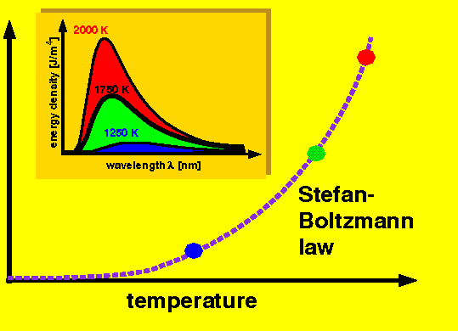
Stefan-Boltzmann Law
Or (in terms of luminosity)
Where:
Relates the total energy (light - including heat) emitted to the temperature of the object

Slide 7
What These Mean Together
Together these allow us to determine many characteristics of a star based on what we can see - how bright it is and what color it is
We can see the color → Wien’s Law gives us surface temperature
We can see the magnitude (brightness) and calculate the distance → Inverse Square Law gives us the Luminosity
Now we know temperature and luminosity → Stefan-Boltzmann Law gives us the star’s radius

Slide 8
Now, The HR Diagram

Slide 9
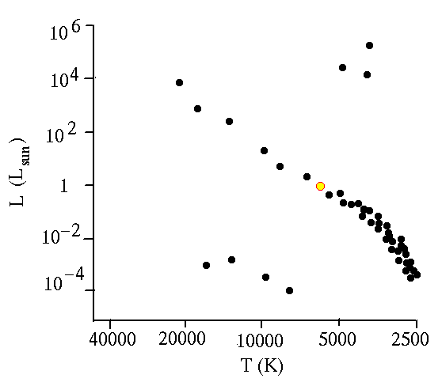
The HR Diagram
Full name is Hertzsprung-Russell Diagram
Named after its creators, E. Hertzsprung and H. N. Russell
It is a graph, the x-axis is the temperature (or color) and the y-axis is their luminosity (or absolute magnitude)
X-axis units are typically Kelvin (no degrees), wavelength/frequency, or color
Color is typically shown as “B-V”, or blue minus visible
It is the brightness in blue wavelengths minus the brightness in visible (or green) wavelengths
Smaller numbers (i.e. negative) are bluer while bigger numbers are closer to red
Y-axis units are typically Lₛᵤₙ (or L⊙) (luminosity) or Absolute Magnitude
Rarely, it will be luminosity in units of power like watts or ergs/s
Note the Direction of the x-axis

Slide 10
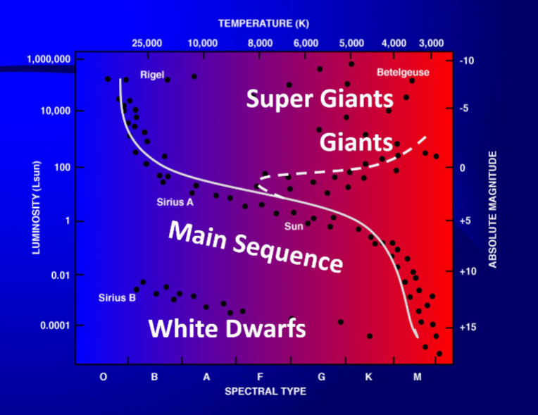
The HR Diagram Cont. (Regions)
When you plot a large number of stars on the HR Diagram, you will see them in several groups or regions
The Main Sequence
Which contains most stars, including the Sun
The Giants and Super Giants
Fairly self-explanatory
White Dwarfs
Remnants of Sun-like stars
Small and white-blue in color
Stars leave the Main Sequence when they run out of Hydrogen to “burn” and start burning Helium
Then they can become giants
And eventually die, leaving behind a neutron star or black hole, or becoming a white dwarf (depending on size)

Slide 11
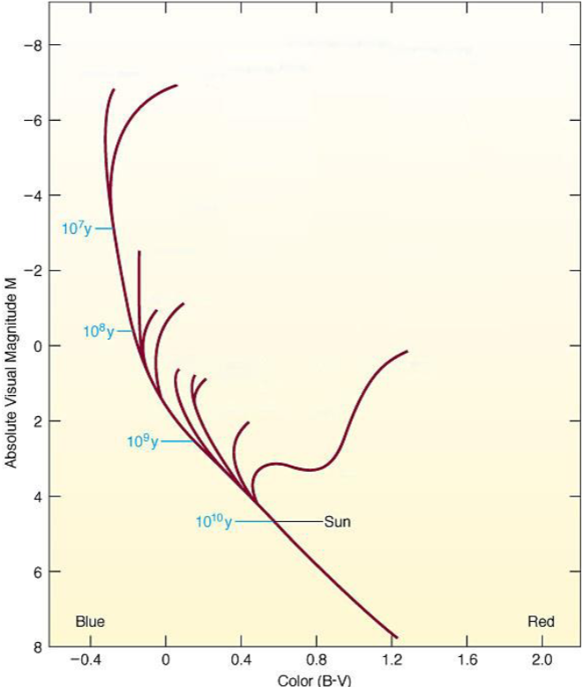
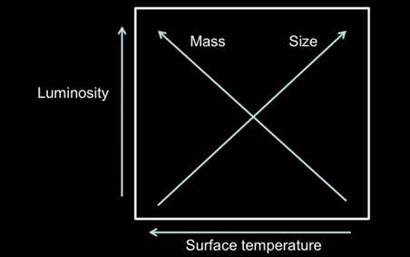
The HR Diagram Cont. (What it Tells us)
Because of the way stars work, the HR Diagram can help us identify more information about them
The mass and size (radius) of the stars increase diagonally on the diagram
Size from left to right, and mass from right to left
We can also determine the age of the cluster of stars plotted on the HR Diagram
This is because less massive stars burn through their Hydrogen more slowly - so they take longer to run out
They leave the Main Sequence later
We can assume all stars in a cluster formed at more or less the same time
So by looking at the turnoff points of a HR Diagram (the top-left most stars still on the main sequence), we can estimate the age of the cluster

Slide 12
Today
You are going to be using the Starry Night (SN) software to collect data
Search for each star in the table on page 6, and fill in all the information about them from what Starry Night says
Then work through questions 1-9 and plot the stars from the table on your own HR Diagram (page 13)
Then you will create a HR Diagram in Starry Night
And answer questions 10-16
Notes on Questions:
Question 7 is worded unclearly, it is asking about the physical size of the stars
Not the number of stars in the group
Question 9 is asking about the mass of the stars
Also, ignore the first sentence, start with “In other words…”
Question 4 is extra credit as are parts b and c of question 8
Part a of question 8 is required as normal
A fair amount of math in this lab:
Take your time
Show your work
Use a calculator
Ask for help
Note: SN may not recognize all of the star names due to being such an old version
Try Sirius instead of Sirius A
Particularly Wezen - Put Delta Canis Majoris when searching for it
It should recognize the name 2 Hya. But if not, search 2 Hydrae instead

